Slide 1



POWER MANAGEMENT & REGULATOR
GROUP -4
SUBMITTED TO – Professor Mike Aleshams
SUBMITTED BY –SIMKY ARORA

Slide 2
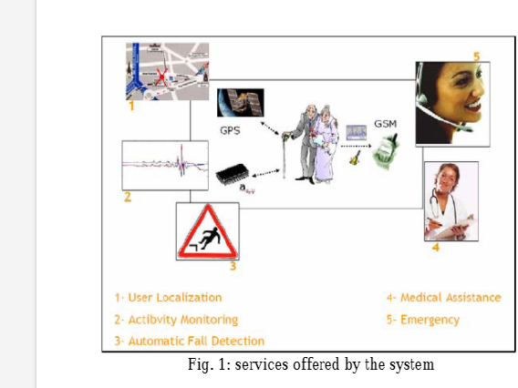
Fall detection and monitoring FOR OLDSTERS

Slide 3
What Is power management ?
Power management is a feature that allows users to control the amount of power consumed by an underlying device, with minimal impact on performance. It enables the switching of devices in various power modes, each with different power usage characteristics related to device performance.

Slide 4
Power manaGement and its need
A set of H/W techniques used to minimize the power consumption of a device while meeting its performance requirements.
To enhance battery life
Lower heat dissipation to increase system stability
Reduces the impact on the environment
Reduced noise

Slide 5

Process
BATTERY
POWER MANAGEMENT UNIT
REGULATOR

Slide 6
Power usage
Definitely, In order to function, all the components consume power. Whereas raspberry pi 4 and GSM module are the components with higher consumption.
Other components have a minimal power consumption .

Slide 7
Components’ requirements
S.N | Name of Components | Voltage | Current
1 | Tactile Push button | 5 V | 1 MA
2 | Raspberry pi 4 | 4.7 V | 3000 MA
3 | Sim 7600 GSM LTE module | 3.7 V | 2500 MA
4 | Neo G-M GPS module | 3.3 V | 45 MA
5 | ESP CAM 32 | 5 V | 128 MA
6 | Heart rate pulse sensor | 5 V | 4MA
7 | Passive low level trigger buzzer alarm sound module | 3.5 V | 20 MA
8 | ADXL 345 sensor | 3.3 V | 2 MA
9 | Temperature sensor | 5 V | 5 MA

Slide 8
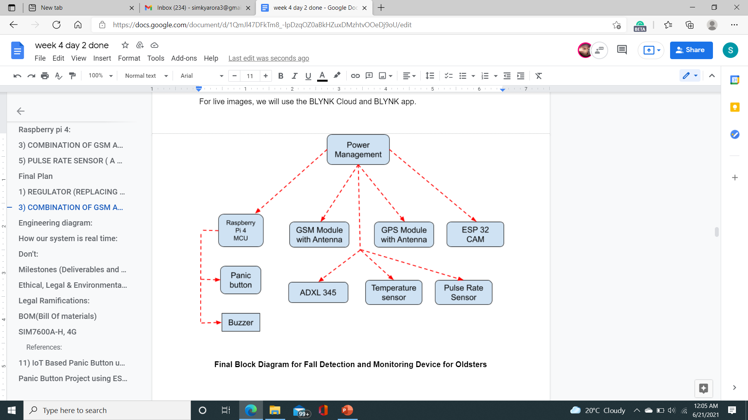
Block Diagram (Power management)

Slide 9
SUPPLY And its calculation
Panic button and buzzer have indirect connections with power management whereas all other components get connected directly with power management .
As 2 cells are in series and these are in parallel of 2 more cells
Voltage from single cell = 3.7 v
As per law , voltage get added as the 2 cells are in series
V in = 7.4 v
Current from single cell = 3000 mA
As per law , current get added as 2 cells are in parallel
I in = 6000 mA

Slide 10
calculations
Total consumption = 5700 mA
The table mentioned the individual consumption.
If total consumption is lesser than the output of source power , so source is capable to power the whole system.

Slide 11
regulators
The primary job of a voltage regulator is to drop a larger voltage to a smaller one and keep it stable, since that regulated voltage is being used to power all other components.
The two digits after the 78 represent the output voltage of the regulator, for example the 7805 is a 5V regulator.

Slide 12
Regulators
1. 78S05 regulator
2. LM323 regulator
Each component of fall detection and monitoring for oldsters project has different voltage and Current requirement .Therefore, We need to use 2 different kind of regulators.

Slide 13
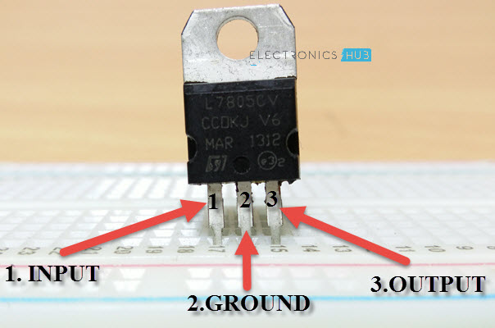
78S05 regulator ic X3 ¼ Pin configuration

Slide 14
78S05 regulator ic
Output current up to 2 A
Output voltages of 5; 7.5; 9; 10; 12; 15; 18; 24 V
Thermal protection
Short circuit protection
Output transition SOA protection (Safe operating area)

Slide 15
LM323 (3–AMPERE, 5 VOLT POSITIVE VOLTAGE REGULATORS)
The LM323,A are monolithic integrated circuits which supply a fixed positive 5.0 V output with a load driving capability in excess of 3.0 A
Features
Output Current in Excess of 3.0 A
Available with 2% Output Voltage Tolerance
No External Components Required .

Slide 16
LM323 (3–AMPERE, 5 VOLT POSITIVE VOLTAGE REGULATORS)
Internal Thermal Overload Protection
Internal Short Circuit Current Limiting
Output Transistor Safe–Area Compensation
Thermal Regulation and Ripple Rejection Have Specified Limits

Slide 17
Connections detail
The Vin of regulator is connected to positive terminal of battery.
GND of regulator is connected to GND of battery .
Vout is provided to components as per requirement .
It works if Vin > Vout.

Slide 18
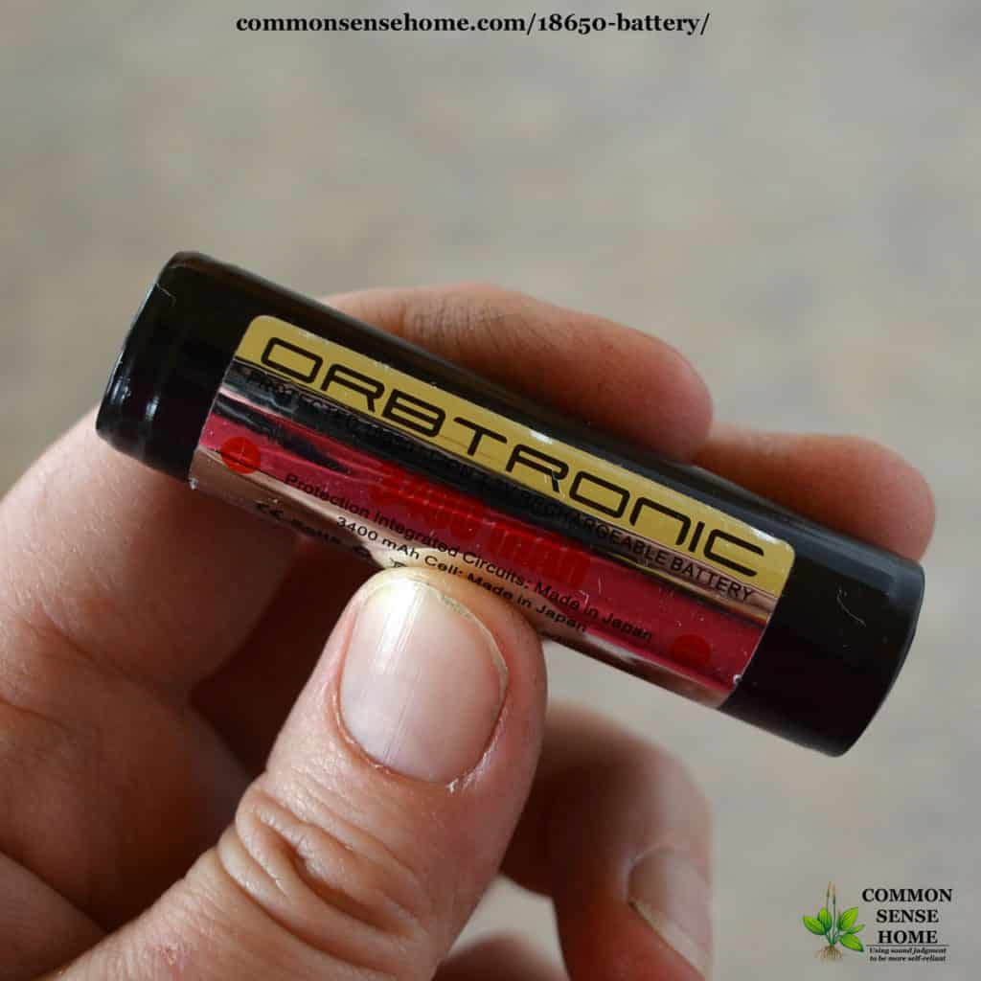
18650 li-ion battery 1/2

Slide 19
What is an 18650?
An 18650 is a lithium ion rechargeable battery. Their proper name is “18650 cell”. The 18650 cell has voltage of 3.7v and has between 1800mAh and 3500mAh (mili-amp-hours).
18650s may have a voltage range between 2.5 volts and 4.2 volts, or a charging voltage of 4.2 volts, but the nominal voltage of a standard 18650 is 3.7 volts

Slide 20
18650 li-ion battery 2/2
18650 batteries are lithium-ion batteries. They get their name from their size: 18mm by 65mm. These batteries not only used in flashlights, but also in: power tools, electric vehicles, vaporizers, cameras, laptops, and more! . It usually takes about 3 hours to charge a 18650 lithium-ion battery fully.

Slide 21
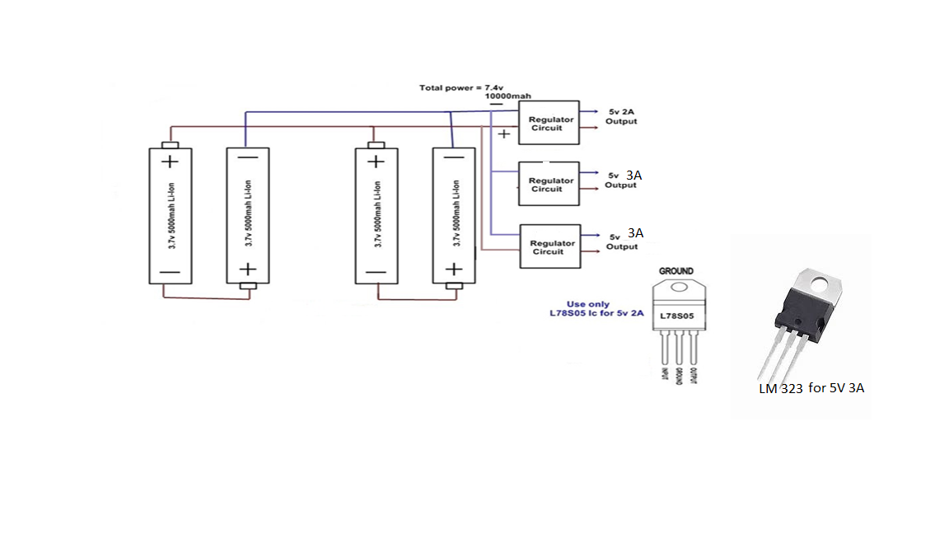
CIRCUIT Diagram

Slide 22
alignment of Components
We are going to use 4 batteries .
2 batteries are in series and other 2 are in parallel of these cells.
2 regulators have been used from those, 1 regulator is used for 5V 2A supply and other are used for 5V 3A supply.

Slide 23
Mathematical detail
Two pair of 2 batteries are connected in series and these pairs are in parallel to each other.
Single cell = 3.7 V and 3000 mA
Total supply will be 7.4 V and 6000 mA

Slide 24
Temperature influence on battery sustainability
The acceptable temperature region for LIBs normally is −20 °C ~ 60 °C. Both low temperature and high temperature that are outside of this region will lead to degradation of performance and irreversible damages, such as lithium plating and thermal runaway. Therefore, understanding the temperature effects and accurate measurement of temperature inside lithium-ion batteries are important for the proper battery management

Slide 25
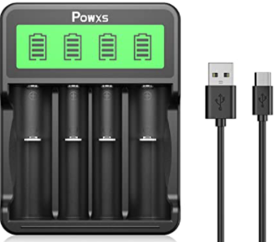
POWXS 18650 Battery Charger 1/3

Slide 26
POWXS 18650 Battery Charger 2/3
Perfectly Fit for: POWXS 18650 battery charger can independently charge 1-4 pcs 21700, 20700, 18650, 18490, 18350, 17670, 17500, 16340(RCR13), 14500 Li-ion or AA/AAA Ni-MH/Ni-CD, or 1-2 pcs 26650, 22650 Li-ion or C rechargeable batteries.
Faster Charging: The charging current is up to 1000mA, 3000mAh Li-ion battery will be fully charged in 3 hours. Saving your waiting time

Slide 27
POWXS 18650 Battery Charger 3/3
LCD Display: The smart battery charger shows the status of charging batteries clearly by the LCD screen.
Input Option: The 18650 battery charger has two input option(Micro-USB and Type-C), applicable for 5V 2A power bank, computer, car charger, USB wall charger and so on.
Safer with Multiple Protection: With advanced MCU control system, intelligent △V and -△V cut-off charging tech, the charger turns to trickle charging automatically to prevent the batteries from over-voltage, over-current and over-heat

Slide 28

How to save power during run time : When GPS AND GSM ARE NOT RECEIVING ANY COMMAND TO INITIATE ANY ALERT .THEREFORE, A MINIMAL AMOUNT OF POWER IS CONSUMED LEADING TO SAVE POWER .

Slide 29
REFERENCE
1) Power management retrieved from What is Power Management? - Definition from Techopedia
https://www.techopedia.com/definition/2116/power-management
2) Power management in embedded system retrieved from
Efficient Power Management In Embedded Systems (daiict.ac.in)
3) Understanding 7805 IC Voltage Regulator, (April 11, 2018) retrieved from 7805 Voltage Regulator IC Circuit Working and Applications (electronicshub.org)
4 )BATTERY CHARGER
POWXS 18650 Battery Charger 4 Bay LCD 18650 Charger for 18650 26650 22650 21700 20700 18490 18350 17670 17500 16340(RCR123) 14500 Li-ion Rechargeable Batteries and C AAA AA Batteries Rechargeable NiMH NiCD available at
POWXS 18650 Battery Charger 4 Bay LCD 18650 Charger for 18650 26650 22650 21700 20700 18490 18350 17670 17500

Slide 30
references
5) Neverman, A. (July 31,2020).EVERYTHING YOU NEED TO KNOW ABOUT THE 18650 BATTERY retrieved from Everything You Need to Know About the 18650 Battery (commonsensehome.com)
6 ) Powering the Pi 4 - safe voltage levels and current requirements
Retrieved from power - Powering the Pi 4 - safe voltage levels and current requirements - Raspberry Pi Stack Exchange
7)GPS AND GSM Description,(n.d).Retrieved from SIM7600EI 4G / 3G / 2G / GSM / GPRS / GPS UART Modem - rhydoLABZ : rhydoLABZ INDIA
8) Buzzer Basics - Technologies, Tones, and Drive Circuits retrieved from
Buzzer Basics - Technologies, Tones, and Drive Circuits | CUI Devices

Slide 31
referencess
9)Pulse sensor retrieved from Pulse Sensor Pinout, Configuration & How Pulse Sensor Works (components101.com)
10)Introduction to DS18B20 retrieved from
Introduction to DS18B20 - The Engineering Projects
11)ADXL 345 Description retrieved from
ADXL345 Datasheet and Product Info | Analog Devices
12) Introduction to the ESP32
ESP32 dev kit power options
How to power your ESP32 development kit, options (techexplorations.com)

Slide 32
REFERENCES
13) ON Semiconductor retrieved from LM323 (onsemi.com)
14) How to connect batteries in series and parallel retrieved from
How To Connect Batteries In Series & Parallel - Power Sonic (power-sonic.com)
15.TinkerCAD online platform available at https://www.google.com/url?sa=t&source=web&rct=j&url=https://www.tinkercad.com/&ved=2ahUKEwjZhcKf2ZjxAhWNXCsKHXaNDaYQFjAAegQINBAC&usg=AOvVaw1JxBDMj3J4tH5_HVKfRPhY&cshid=1623727771038
16.Voltage Regulator retrieved from What is Voltage Regulator and How Does It Work? (components101.com)

Slide 33

THANK YOU

